Slide 1
Intuitive and Reflective Moral Reasoning Across Cultures
John Michael & Steve Butterfill

Slide 2
Overview
Some Background
The Bago & De Neys Study
Proposed Study
Questions…

Slide 3
1. Some Background

Slide 4
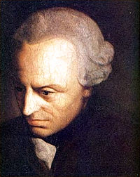
Deontology: Rightness or wrongness derives from the behavior itself.
Kant
Always wrong to lie,
break promises, kill, etc

Slide 5
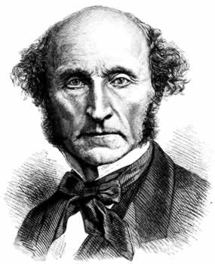
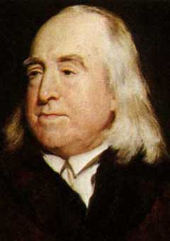
Consequentialism: “The ends justify the means”
Utilitarianism: “The greatest possible good to the greatest number of people”
→Sometimes may be ok to lie, break promises, kill, etc
Jeremy Bentham J.S. Mill

Slide 6
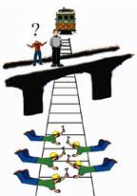
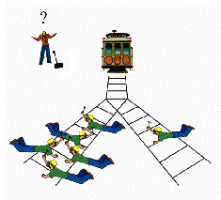
Deontological versus Utilitarian intuitions

Slide 7
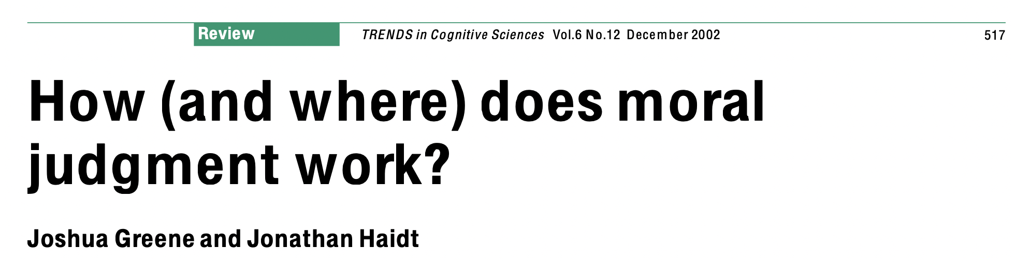
Imaging Studies and the Trolley Dilemma
Not pushing the large man:
Greater activation in areas involved in the production of emotionally backed moral judgments, integration of emotion into decision-making and planning (medial frontal gyrus), representation of reward and punishment (Orbitofrontal and ventromedial areas), affective representation (posterior cingulate and STS)
Pushing the large man:
Areas associated with working memory and inferential reasoning (dorsolateral prefrontal cortex) involved in the impersonal moral judgments.
Notes:
Further evidence that emotions are involved: Trapdoor manipulation;

Slide 8
Dual process theories and moral cognition
A is now entitled to expect B to do X and to rely on that expectation.
B has an obligation to A to do X.
Dual process theories:
Fast, effortless, and intuitive (i.e., so-called “System 1”) vs. slow, cognitively demanding, deliberate (i.e., so-called “System 2”) processing on the other.
Greene, Haidt, and others:
System 1 processing → deontological judgments
System 2 processing → utilitarian judgments
A core idea is that giving a utilitarian response to moral dilemmas requires that one engages in System 2 thinking and allocates cognitive resources to override an intuitively cued intuitive System 1 response that primes us not to harm others

Slide 9
2. The Bago & De Neys Study

Slide 10
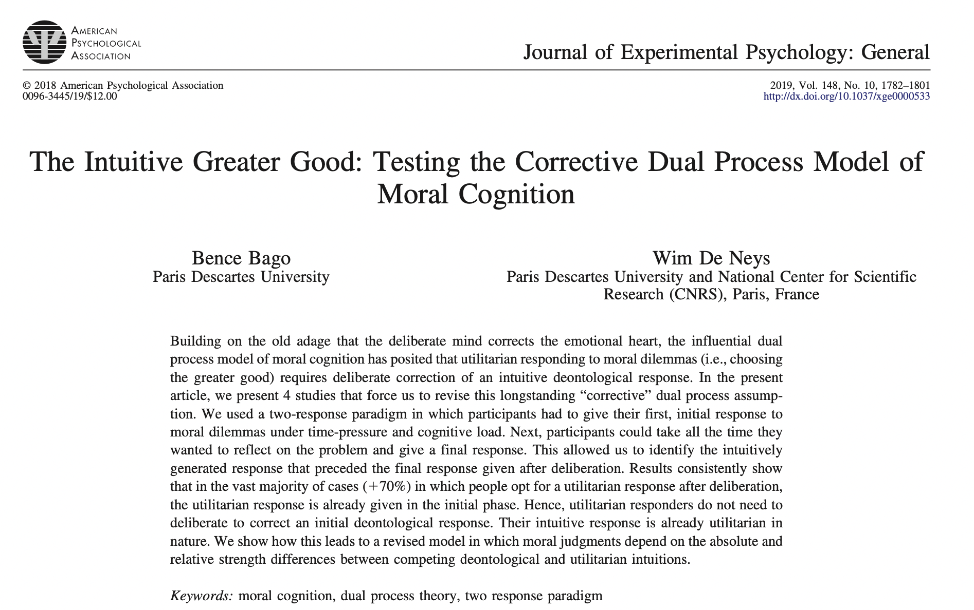
Dual process theories and moral cognition
A is now entitled to expect B to do X and to rely on that expectation.
B has an obligation to A to do X.

Slide 11
Conflict Trials (Study 1)
Due to an accident there are 11 miners stuck in one of the shafts of a copper mine. They are almost out of oxygen and will die if nothing is done. You are the leader of the rescue team.
The only way for you to save the miners is to activate an emergency circuit that will transfer oxygen from a nearby shaft into the shaft where the 11 miners are stuck.
However, your team notices that there are 3 other miners trapped in the nearby shaft. If you activate the emergency circuit to transfer the oxygen, these 3 miners will be killed, but the 11 miners will be saved.
Would you activate the emergency circuit?
X Yes X No
→Each participant did 4 of these

Slide 12
No-Conflict Trials (Study 1)
Due to an accident there are 3 miners stuck in one of the shafts of a copper mine. They are almost out of oxygen and will die if nothing is done. You are the leader of the rescue team.
The only way for you to save the miners is to activate an emergency circuit that will transfer oxygen from a nearby shaft into the shaft where the 11 miners are stuck.
However, your team notices that there are 11 other miners trapped in the nearby shaft. If you activate the emergency circuit to transfer the oxygen, these 11 miners will be killed, but the 3 miners will be saved.
Would you activate the emergency circuit?
X Yes X No
→Each participant did 4 of these

Slide 13
Trial Structure
Dot Matrix Presentation (cognitive load): 2000 ms
Reasoning Problem(first half): no time limit
Reasoning Problem(second half): 12 sec
Confidence Rating
Dot Matrix Options
Reasoning Problem(full): no time limit
Confidence Rating

Slide 14
Conflict Trials (Study 2)
Due to an accident there are 11 miners stuck in one of the shafts of a copper mine. They are almost out of oxygen and will die if nothing is done. You are the leader of the rescue team.
The only way for you to save the miners is to activate an emergency circuit that will transfer oxygen from a nearby shaft into the shaft where the 11 miners are stuck.
However, your team notices that your own father and two other miners are trapped in the nearby shaft. If you activate the emergency circuit to transfer the oxygen, your father and the two other miners will be killed, but the 11 miners will be saved.
Would you activate the emergency circuit?
X Yes X No

Slide 15
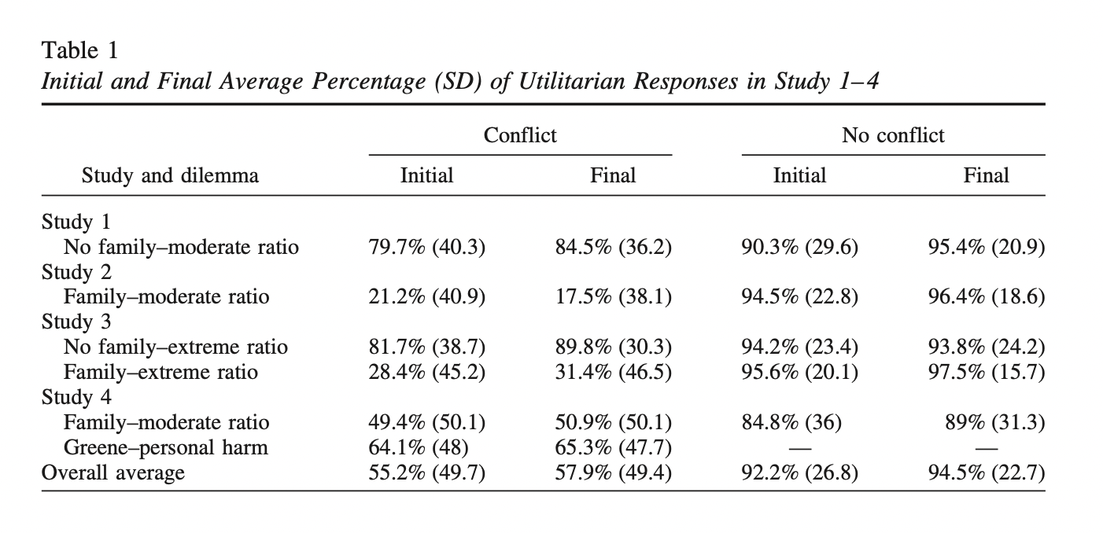
Results

Slide 16
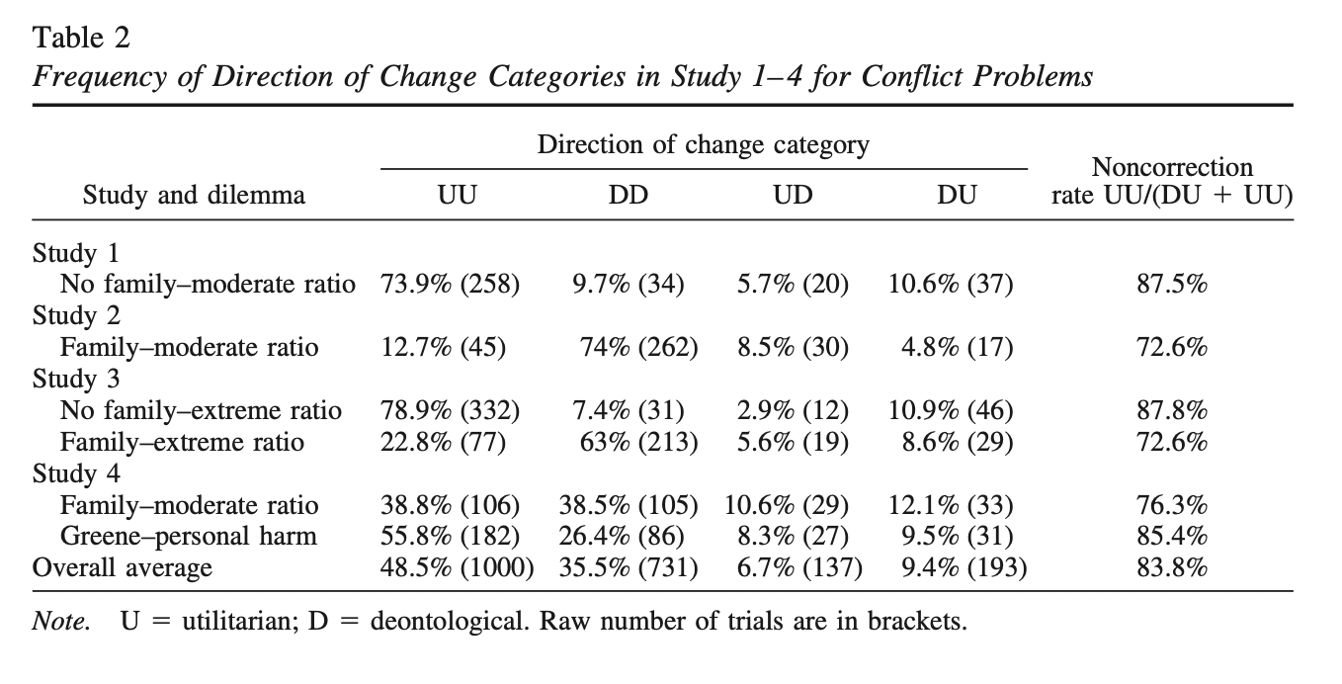
Results

Slide 17
3. Proposed Study

Slide 18
Intuitive and Reflective Moral Judgments Across Cultures
What differences should we expect if we replicate the study in a more interdependent/collectivist culture?
Prediction: More favoritism/tribalism (presence of a family member should matter more) in more interdependent cultures
If we observe cultural differences, should we expect to see them in the quick, intuitive responses? In the reflective responses? Both?

Slide 19
4. Open Questions

Slide 20
Cross-Cultural
What cultures?
Replicate study 2 only across cultures, or incorporate the presence/absence of a family member as a factor?
What kind of analyses should we do? Or how might we want to change the design/measures, given that we are adding a factor (culture)?
Ethics
Funding
Qualtrics license

